Slide 1


BENNETT UNIVERSITY
www.bennett.edu.in
Notes:
Add Caption : Expect More

Slide 2
Human Activity Recognition
Guides: Dr. K.K. Biswas, Dr. Suneet Gupta
Presented by : Mohit Agarwal
PhD. scholar – CSE
E17SOE811

Slide 3
Outline of Presentation
Introduction
Problem Statement
Use Case
Literature Review
Related Research Work Done
References

Slide 4
Introduction
Human activities are the set of actions performed by human while doing some task. E.g.: walking, running, waving hand, working, eating etc.
Humans can learn easily and identify what action is being performed at certain time by other individual(s).
We need to automatically detect human activities and report any unusual activity like theft, accident or falling of elderly people.

Slide 5
Introduction (contd..)
Surveillance
Stealing, present in late hours, standing near cupboard, working on computer, sleeping on desk,
School surveillance
Proper class, students making noise, only 2 persons in a room, few students fighting, no teacher.

Slide 6
Problem Statement
The objective is to detect some predefined actions of human subjects in indoor and outdoor environment using RGB cameras so that the work can easily be used with installed CCTV cameras.

Slide 7
Use Case
The intent to identify human actions is to help in these cases:
When elderly person alone at home is having some attention need like falling, shivering, crying etc.
When some theft or accident has happened in public place to alarm the police for fast action automatically.

Slide 8
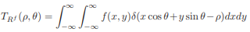
Literature Review
[1] Human Activity Recognition Based on R Transform, Ying Wang, Kaiqi Huang andTieniu Tan, 1-4244-1180-7/07/$25.00 ©2007 IEEE
Silhouette of person is easily obtained by background subtraction and binarization.
From the silhouette bounding box following is done to get R transform:

Slide 9
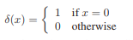
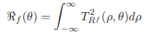
Literature Review (contd..)
Here ρ € [-∞, ∞] and
An improved transform is given by equation:

Slide 10
Literature Review (contd..)
R transform is invariant to translation and scaling changes only amplitude.
Rotation of human silhouette by θ also rotates transform by θ.
For each frame authors get a 180-dimension vector, for each θ from 0 to 180.
Each vector is divided into 3 parts to get matrix of 60*3.

Slide 11
Literature Review (contd..)
Then PCA is used to get a matrix of size 2*3 and finally by appending rows of this matrix a vector of 6*1 shape is formed.
This vector is used to train Hidden Markov Model.
On testing with actions not in training dataset an accuracy of ~ 95% is achieved.

Slide 12
Literature Review (contd..)
[2] Human Activity Recognition with Metric Learning, Du Tran and Alexander Sorokin, ECCV 2008, Part I, LNCS 5302, pp. 548–561, 2008. Springer-Verlag Berlin Heidelberg 2008.
Author uses background subtraction to get silhouette region of human which is scaled to 120 pixel of larger side keeping aspect ratio
This is placed on centre of 120 by 120 square and padded with 0’s in region where it is not overlapping square

Slide 13
Literature Review (contd..)
This square is divided into 2 by 2 sub squares.
Each square is divided into 18 radial regions from center of squares and 3 separate vectors are prepared of length 18*2*2 = 72
Three vectors are prepared using motion values using Lucas Kanade and by taking Fx and Fy values and also the silhouette binarized values by integrating over each radial region of 20 degrees.

Slide 14
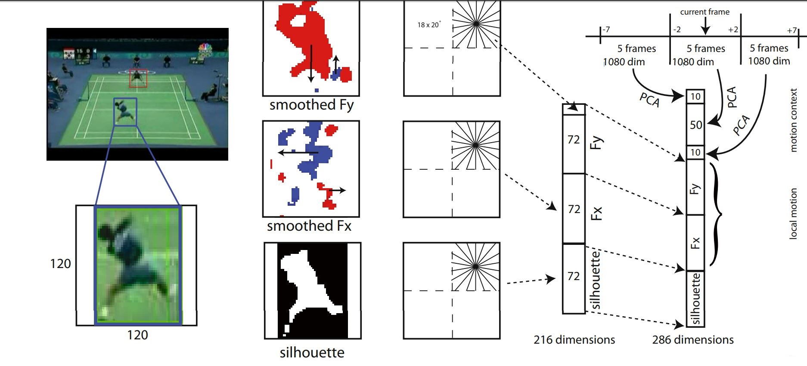
Literature Review (contd..)
Figure 1

Slide 15
Literature Review (contd..)
These 72 length vectors are appended to get 216 length vector.
Authors uses 15 fps rate of sampling and use 5 frames each for past, present and future frames.
The 216 length vector made in previous step is stacked together to make 5*216 = 1080 length vector.
PCA is further used to reduce to vector size to 10 for past, 50 for present and 10 for future frames.

Slide 16
Literature Review (contd..)
This 70 length descriptor is appended to 216 length vector in previous step and 286 length vector is produced.
Author uses this vector in algorithms such as Naïve Bayes, 1 nearest neighbour with rejection and metric learning.
On testing with standard datasets: Weizman, IXMAS, UMD and authors own dataset accuracy found was in high 90s percent.

Slide 17
Literature Review (contd..)
[3] Video Representation Learning Using Discriminative Pooling, Jue Wang, Anoop Cherian,Fatih Porikli and Stephen Gould, Accepted in CVPR2018, arXiv:1803.10628v2 [cs.CV] 29 Mar 2018
Author proposes SVMP – Support Vector Machine Pooled algorithm for classifying human action from videos.
Initially videos are broken into frames and they are converted to feature vectors.

Slide 18
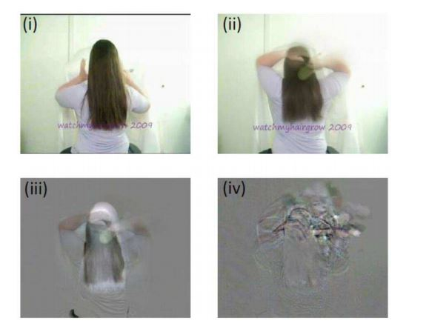
Literature Review (contd..)
Discriminative
Pooling:
Sample frame
Average pooling
Rank pooling
SVM pooling

Slide 19
Literature Review (contd..)
For each training video positive bag of feature set is made while are from CNN intermediate layer or hand crafted.
Negative bag of feature set is created using ActivityNet dataset, UCF-101 dataset, Thumos Challenge background sequence and synthesized random white noise image sequences.
These positive and negative features are passed to SVM to learn weight w and bias b for separating hyperplane.

Slide 20
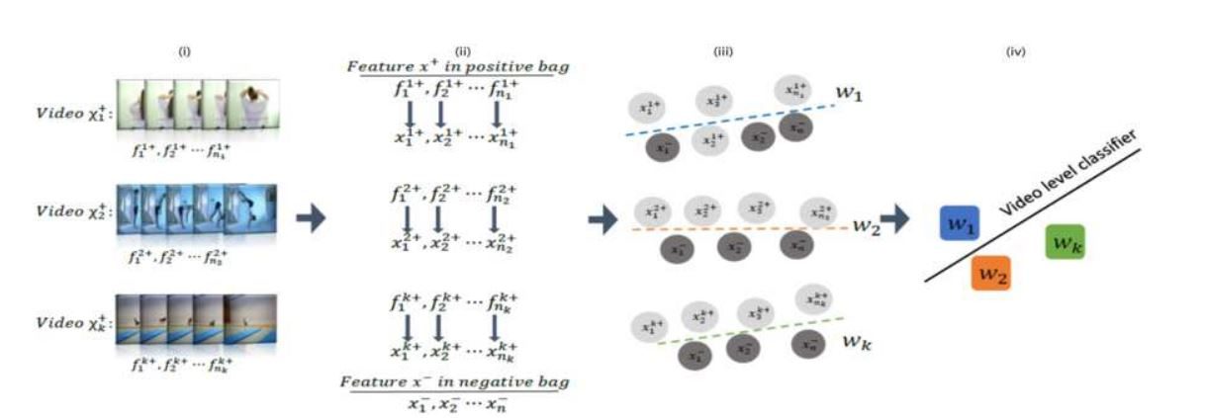
Literature Review (contd..)
Steps in SMP pooling to get the separating hyperplane

Slide 21
Literature Review (contd..)
Hyperplane is calculated between positive and negative bag of features such that a fraction of positive bag features lie on one side of hyperplane.
Author chooses this fraction = 0.9 for their experiment.
Like this a weight vector is calculated for each action video.
This weight vector is further passed to a CNN to classify the actions in one of 10 classes of actions based on max pooling.

Slide 22
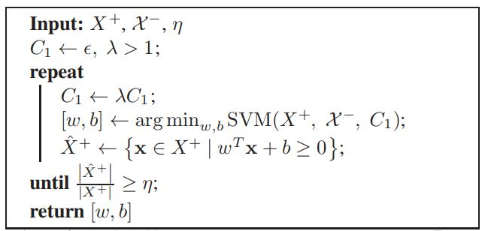
Literature Review (contd..)
Algorithm to get optimum [w,b]

Slide 23
Literature Review (contd..)
When testing we transform the video into similar weight vector by above steps and pass to CNN to know the class of action in the video.
Author achieves maximum 81.3% accuracy on HMDB51 dataset.

Slide 24
Literature Review (contd..)
[4] Social Scene Understanding: End-to-End Multi-Person Action Localization and Collective Activity Recognition, Timur Bagautdinov, Alexandre Alahi, Franc¸ois Fleuret, Pascal Fua, Silvio Savarese, 1063-6919/17 $31.00 © 2017 IEEE, 2017 IEEE Conference on Computer Vision and Pattern Recognition
Authors proposes to pass each frame of video to a Fully Convolution Network (FCN) to produce a dense feature set.

Slide 25
Literature Review (contd..)
These are then passed to Detection Fully Convolution Network (DFCN) which uses Markov Random Field (MRF) to produce a subset of features with bounding boxes around persons in the frame.
These bounding boxes are used to create fixed sized feature maps which is the area of bounding boxes.
These new feature sets are passed to RNN to know at each time step t-1 and t the probability of action performed by a person in a bounding box.

Slide 26
Literature Review (contd..)
Thus, it can label all the persons in a video with their corresponding action being performed by them – e.g. standing, waiting, walking, moving etc.
Collective activity is recognized using concatenating intermediate action feature maps vectors to a single vector resized to same size and passed to RNN to know the collective action.
Authors experimented on publicly available volleyball dataset.

Slide 27
Literature Review (contd..)
Volleyball dataset has 55 volleyball games and 4830 labelled frames with bounding boxes and 1 of 9 actions performed by them.
The approach described above is used to detect individual and collective action in the video.
Accuracy of 89.9 % is achieved by this method for collective action and 82.4% for individual actions.

Slide 28
Literature Review (contd..)
[5] MiCT: Mixed 3D/2D Convolutional Tube for Human Action Recognition, Yizhou Zhou, Xiaoyan Sun, Zheng-Jun Zha, Wenjun Zeng, accepted in CVPR 2018
MiCT is proposed to enhance existing 3D CNN designs.
Authors have used 2D CNN for individual frames and added the intermediate output with 3D CNN output taking video as input.
These intermediate outputs are again fed to 2D CNN to give output values of MiCT layer of network.

Slide 29
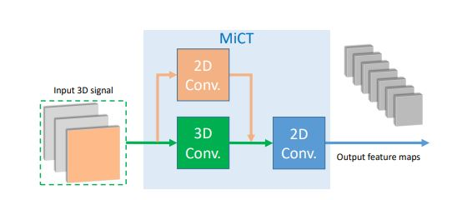
Literature Review (contd..)
Architecture Diagram:

Slide 30
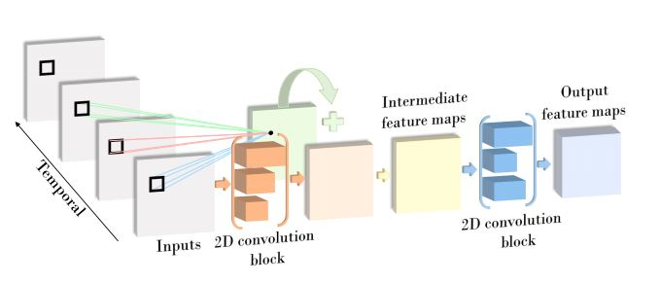
Literature Review (contd..)
Architecture Diagram - illustrated:

Slide 31
Literature Review (contd..)
The network is made of 4 such MiCT layers to form MiCT-Net which is end to end trainable.
Authors find the accuracies for UCF101 and HMDB51 standard datasets outperform existing state of art values.
Authors further proposes 2 stream MiCT-Net in which 1 stream take RGB values as input and in other stream take motion vector values as inputs.
This helps to further enhance the accuracy to 94.7% for UCF101 dataset and 70.5% for HMDB51 dataset.

Slide 32
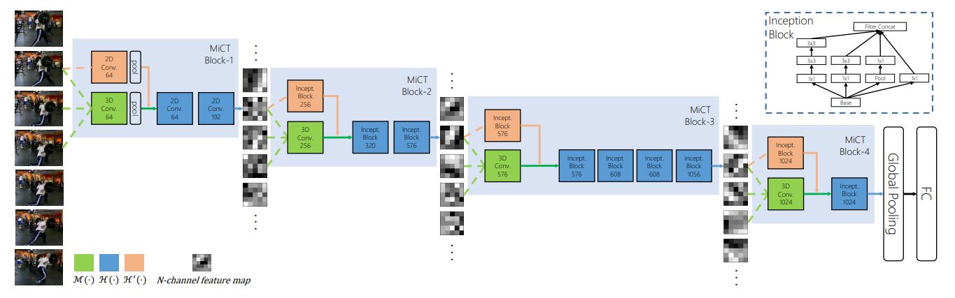
Literature Review (contd..)
MiCT –net

Slide 33
Literature Review (contd..)
[6] Modeling Human Activity From Voxel Person Using Fuzzy Logic, Derek Anderson, Robert H. Luke, James M. Keller, Marjorie Skubic, Marilyn J. Rantz, and Myra A. Aud, IEEE TRANSACTIONS ON FUZZY SYSTEMS, VOL. 17, NO. 1, FEBRUARY 2009
Authors have proposed a fuzzy based approach to identify human activities particularly for elderly care.
In the start of process a voxel person is constructed using overlapping silhouettes from cameras at different orientation in a room.

Slide 34
Literature Review (contd..)
These voxels are then used to calculate the centroid, eigen height and similarity between ground normal and persons primary orientation.
Fuzzy rules are created for these 3 values between High, Medium and Low and corresponding position of person.
After applying Mamdani method of If Else conditions defuzzification is applied to know actual state of person.

Slide 35
Literature Review (contd..)
For elderly Fall recognition 3 states are used:
Upright - with medium height centroid, large height and high similarity between ground normal and persons primary orientation
Lying – with low height centroid, low height and low similarity between ground normal and persons primary orientation
In between – with medium height centroid, medium height and non-identifiable primary orientation or high similarity between ground normal and persons primary orientation

Slide 36
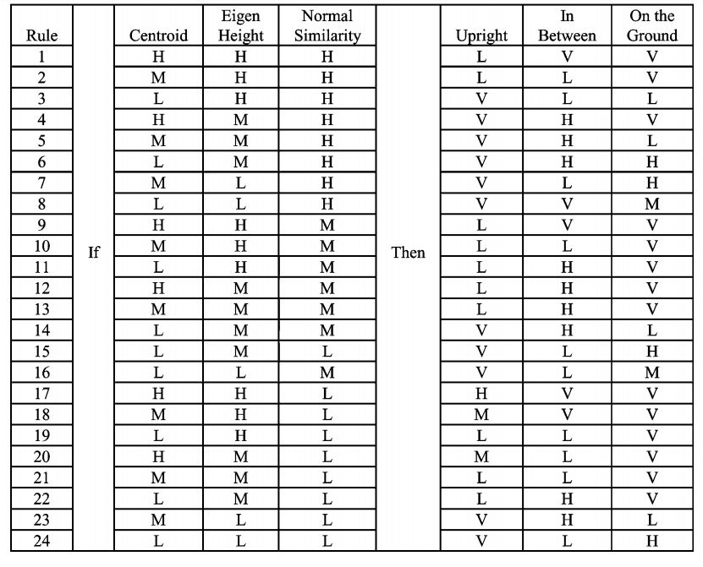
Literature Review (contd..)

Slide 37
Literature Review (contd..)
After defuzzification the video from different cameras can help in elderly care and detect when the person has fallen or some activity which needs attention.

Slide 38
Literature Review (contd..)
[7] Human Movement Modeling and Activity Perception Based on Fiber-Optic Sensing System, Qingquan Sun, Fei Hu, and Qi Hao, IEEE TRANSACTIONS ON HUMAN-MACHINE SYSTEMS, VOL. 44, NO. 6, DECEMBER 2014
Authors have tried to make a fiber optic based human activity detection system in indoor environment.
Author divide the floor in 8 by 8 matrix and using the fiber optics they can detect the position person is currently on.

Slide 39
Literature Review (contd..)
Using the time information, they can detect which direction person is moving or is not moving at all.
Thus, using block and motion information system can be trained using samples for walking, walking while thinking and resting or working activities.
When a test sequence is given using the probability of sequence from training sequences the activity can be predicted.

Slide 40
Literature Review (contd..)
If more than 2 blocks are giving fiber optic signal then we can assume more than 1 person is present and we can make 2 sequences tracking adjacent blocks and match activity of 2 persons.
In the above way author is able to track these activities: Walking, Working, Resting Walking & Working, Talking with around 90% correct detection.

Slide 41
Related Research completed
Papers accepted:
I Convoluted Cosmos: Classifying Galaxy Images using Deep Learning
Authors: Diganta Misra, Sachi Nandan Mohanty, Mohit Agarwal, Suneet K. Gupta
Conference: 3rd International Conference on Data Management, Analytics & Innovation, Venue: Kuala Lumpur, Malaysia | Date: 18 - 20 January, 2019
To be published in: Conference Proceedings by Springer.

Slide 42
Related Research completed
Papers accepted:
II Potato crop disease classification using Convolutional Neural Network
Authors: Mohit Agarwal, Diganta Misra, Amit Sinha, Rahul Mishra and Suneet Gupta
Conference: Smart IOT Systems: Innovations In Computing , Venue: Manipal University Jaipur | Date: 18 - 20 January, 2019
To be published in: Conference Proceedings by Springer.

Slide 43
Related Research
Papers to be submitted for SCI-indexed journal:
III Identification of plant leaves diseases using Deep Convolutional Neural Network
Authors: Arun Pandian J, Mohit Agarwal , G Geetharamani , Suneet Kumar Gupta , K. K. Biswas

Slide 44
Related Research
Introduction:
The Deep CNN model is trained on an open dataset having 54305 images of different plants leaves and 1143 images of without any leaves.
The proposed Deep CNN model has trained for different number of epochs varying from 500 to 3000 on augmented and non-augmented dataset.

Slide 45
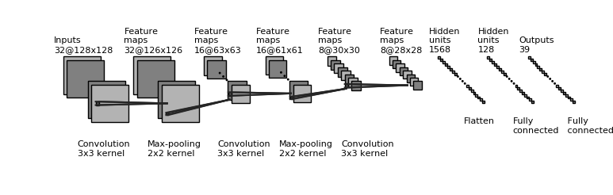
Related Research
Architecture Diagram:

Slide 46
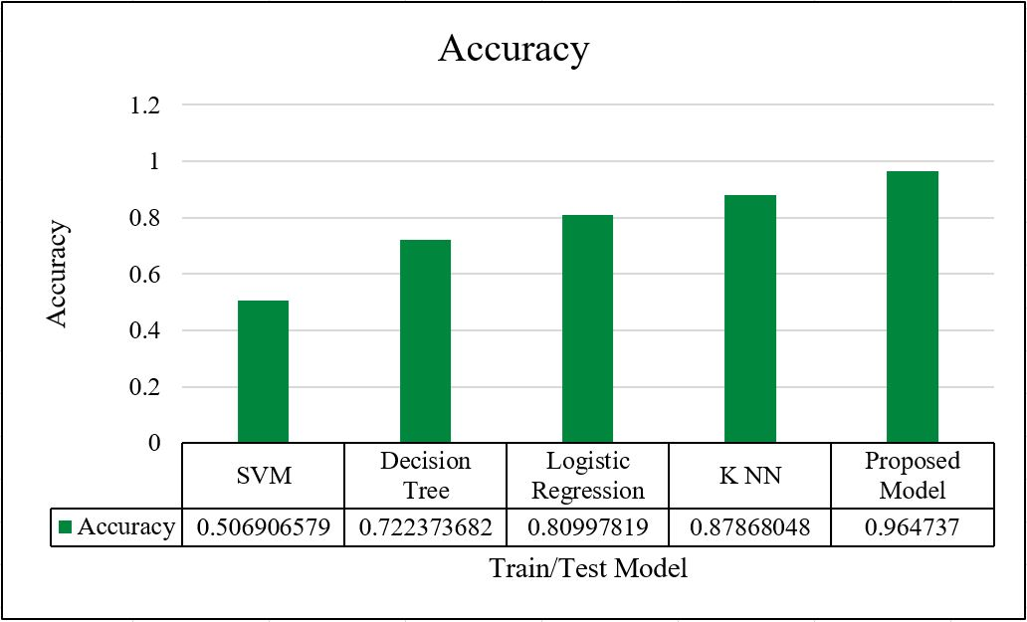
Related Research
Accuracy comparison with other models:

Slide 47
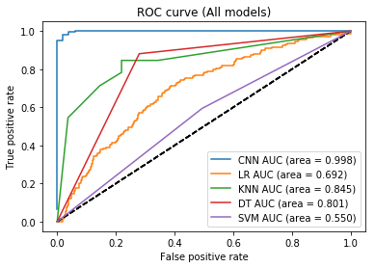
Related Research
ROC Curves of all models:

Slide 48
References
[1] Human Activity Recognition Based on R Transform, Ying Wang, Kaiqi Huang andTieniu Tan, 1-4244-1180-7/07/$25.00 ©2007 IEEE
[2] Human Activity Recognition with Metric Learning, Du Tran and Alexander Sorokin, ECCV 2008, Part I, LNCS 5302, pp. 548–561, 2008. Springer-Verlag Berlin Heidelberg 2008
[3] Video Representation Learning Using Discriminative Pooling, Jue Wang, Anoop Cherian,Fatih Porikli and Stephen Gould, Accepted in CVPR2018, arXiv:1803.10628v2 [cs.CV] 29 Mar 2018
[4] Social Scene Understanding: End-to-End Multi-Person Action Localization and Collective Activity Recognition, Timur Bagautdinov, Alexandre Alahi, Franc¸ois Fleuret, Pascal Fua, Silvio Savarese, 1063-6919/17 $31.00 © 2017 IEEE, 2017 IEEE Conference on Computer Vision and Pattern Recognition
[5] MiCT: Mixed 3D/2D Convolutional Tube for Human Action Recognition, Yizhou Zhou, Xiaoyan Sun, Zheng-Jun Zha, Wenjun Zeng, accepted in CVPR 2018
[6] Modeling Human Activity From Voxel Person Using Fuzzy Logic, Derek Anderson, Robert H. Luke, James M. Keller, Marjorie Skubic, Marilyn J. Rantz, and Myra A. Aud, IEEE TRANSACTIONS ON FUZZY SYSTEMS, VOL. 17, NO. 1, FEBRUARY 2009
[7] Human Movement Modeling and Activity Perception Based on Fiber-Optic Sensing System, Qingquan Sun, Fei Hu, and Qi Hao, IEEE TRANSACTIONS ON HUMAN-MACHINE SYSTEMS, VOL. 44, NO. 6, DECEMBER 2014

Slide 49
Thank You…

